Slide 1

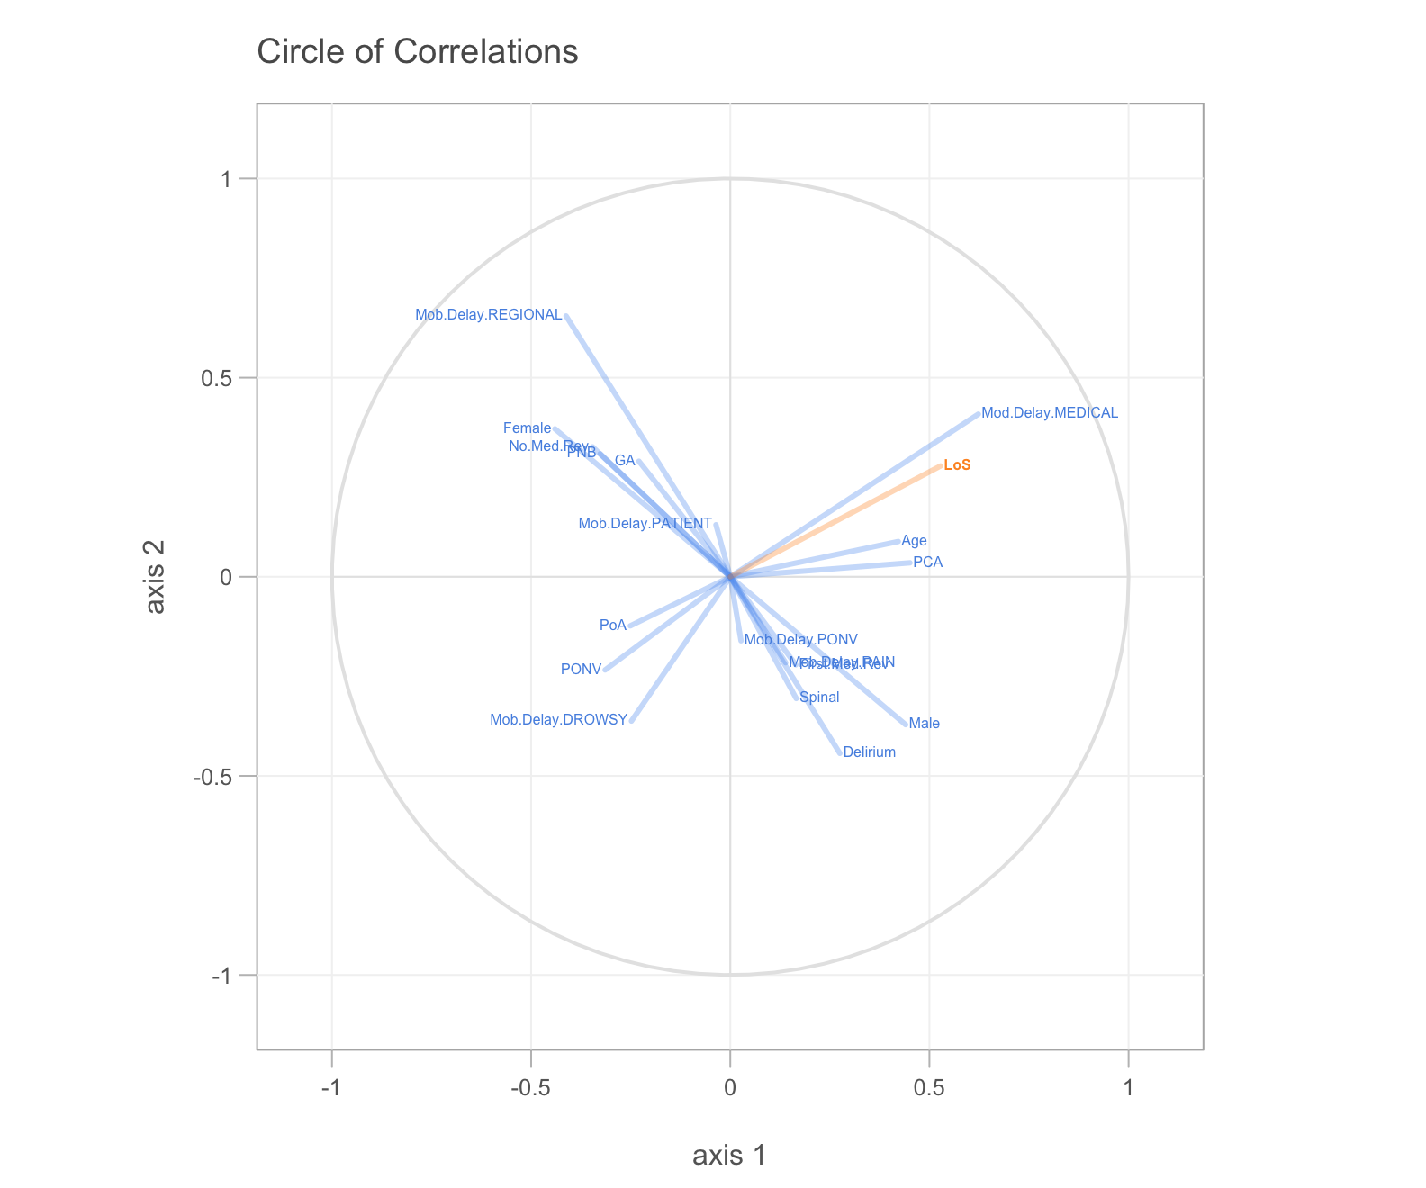
R Workshop
SMART Course 2018
Romit Samanta PhD Student, Summers Lab St7 Anaesthetics & ICM
rs307@cam.ac.uk @dr_romster

Slide 2
HEALTH WARNING

Slide 3
http://bit.do/SMART-R
Download the ‘zip’ file to the Desktop and double click on it

Slide 4
Areas to cover
R basics
Using R for your projects
Data science

Slide 5
Big Data
Automatically collected data
Data quality
‘Machine Learning’

Slide 6



Slide 7
Excel is limited
models
maths
data sizes
Nice graphs, customisable
Forgiving – tells you where the errors are
Whitespace tolerant
Web Resources
Biological-slant
Workflows

Slide 8
Alternatives
Matlab – Matrix calculations (££££)
SPSS – better GUI (££)
Python – (Free)
Graphpad PRISM – (££), no coding
Countless other

Slide 9
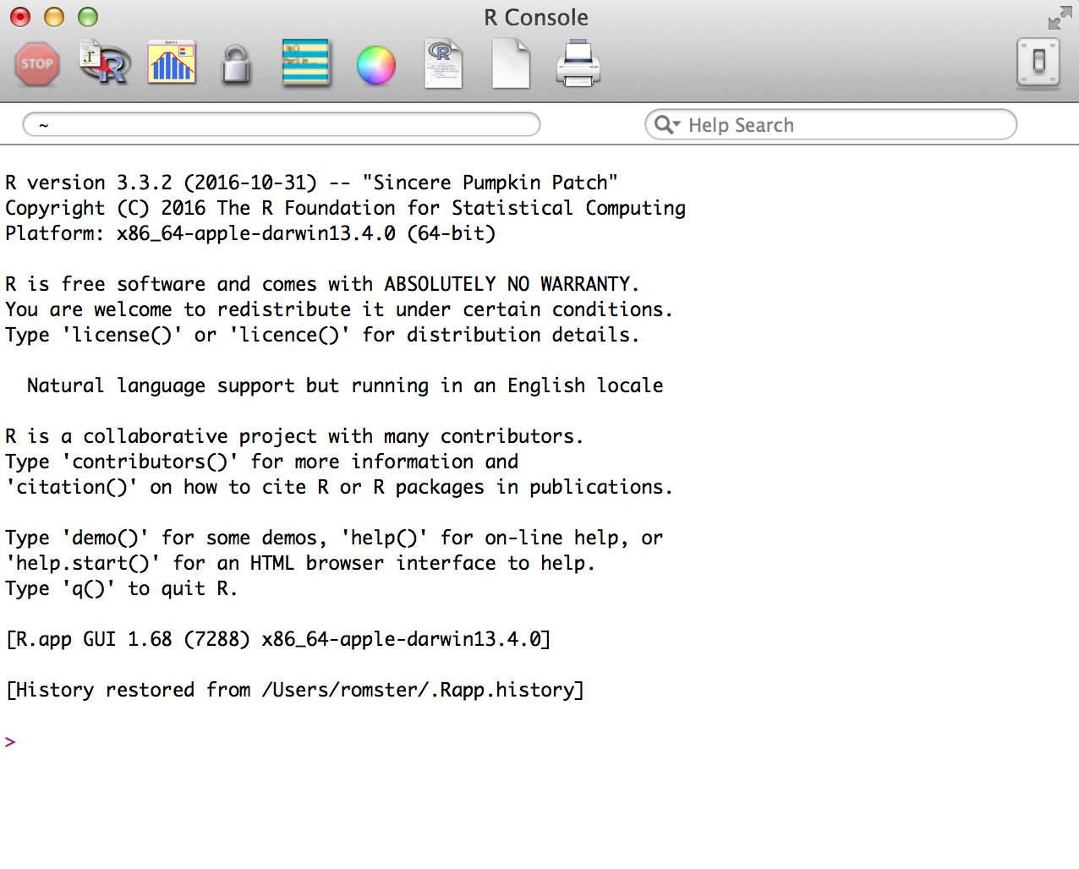

Slide 10
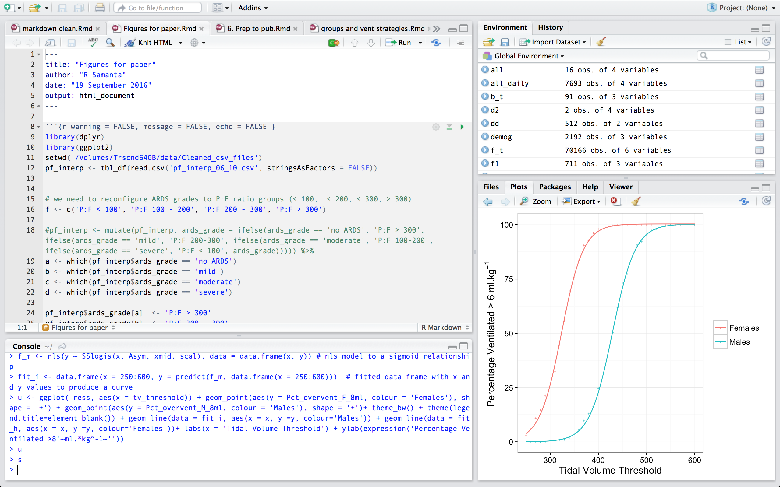
Editor
Environment
Output
Console
Notes:
Why is R good?
Excel is limited
models
maths
data sizes
Much faster
Nice graphs, customisable
Forgiving – tells you where the errors are
Web Resources
Biological-slant
Workflows
Alternatives
Matlab – Matrix calculations
SPSS – better GUI
Pyhton – ‘ the future’ of entry level
Problems
Need to do some coding and understand some basic level computer programming terms
variable, data frame, function, factor
Doesn’t interface too well with other languages (perhaps with the exception of C++ and SQL)

Slide 11
OUTPUT
3rd Party
Libraries
R Studio
User content
R
S3 / S4 / C
Machine Code

Slide 12
Variables store and allow us to access information that we assign to them
Variables can contain:
Numbers (integers or decimals)
Text (strings which are contained in “ ” or ‘ ’)
Combinations of both

Slide 13
To create a variable all we have to do is assign something to it
Assignment is done with either <- or =
Whenever we ‘call’ or reference the variable the computer will recall the value(s) contained
a
a <- 1
b <- “Male”
b
##[1] “Male”

Slide 14
Variable names can be any text but don’t use spaces or special characters [ ^*%$@#! |~]
They are case sensitive
You can use _ or .
bad code <- ‘me’ X
better_code <- ‘you’ OK

Slide 15
Adding more values to a variable is called concatention ( combining ) and is done in R with
c ( bits, to, be, joined, up, separated, by, commas )
number <- c ( 1, 2, 3, 4 )
sex <- c ( “Male”, “Female” )

Slide 16
R notation
Variable / Vector
Assignment ‘ <- ‘ or ‘ = ‘
Text, numbers, categories
Text is often referred to as strings and must be entered within “ ” or ‘ ‘
Calling a variable
Mathematical operators: * / + -
Logical operators: == & | > < >= <=
Absent values: NA NULL
Concatenate: c ( )
a
a <- 1
b <- “Male”
b
##[1] “Male”
b <- c(“Male”, “Female”)
d <- c(0,1,2,3,5,8,13,21)

Slide 17
Exercise 1

Slide 18

Open R Studio
Create a new script [hint: ]
Create a variable ‘a’ consisting of text strings:
John, Paul, George, Ringo

Slide 19
Create a vector ‘b’ consisting of the numbers:
200, 515, 180 , 160
Divide every component of b by 2

Slide 20
Exercise 2

Slide 21
R Notation
Data frame
Data table consisting of row / columns
Selecting rows or columns
e[ row #, column # ] vs
e$column_name
Selecting individual elements
e[[ ]]
e <- data.frame(a,b)
?data.frame()
e[1,]
e[,1]
e$a
e[[2]]

Slide 22
Combine the elements a and b into a data frame e using the data.frame( ) function
Call e

Slide 23
Data Frame
Selecting the correct data
e [ rows, columns ]
e [ 1, ]
e [ , 1]
e [1,1]

Slide 24
Data Frame
Naming columns and rows
colnames ( dataframe ) <- c( “text1”, “text2” )
colnames (e) <- c(‘Beatle’, ‘worth’)
Once a column is named we can access it using ‘$’
e$Beatle
e$worth

Slide 25
R Notation
Functions
In built (or user created code) that take
Inputs
Arguments
Generates an output
c ( )
plot ( )
data.frame ( )
?function_name
Notes:
Case sensitive, white space blind

Slide 26
Exercise 3

Slide 27
Anatomy of a function
x <- seq(0, 50, 5)
y <- seq(0, 200, 20)
plot ( x , y, xlab = ‘Time’ )
y2 <- seq(0 ,100, 10)
Function Name
Input variable(s)
Argument(s)
points(x, y2, col = ‘red’)

Slide 28
Exercise 4

Slide 29
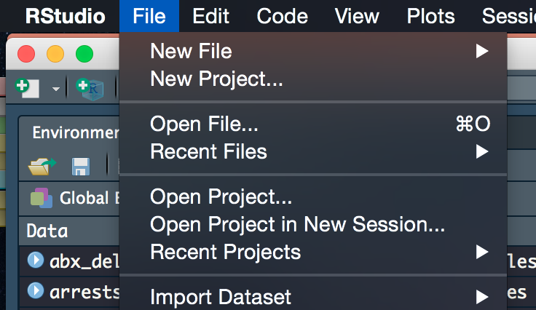
In R Studio:
File menu…
Open File…
Desktop → qicharts2_wrkshp
→ qicharts2_wrkshp.Rdata
or in R Studio type:
load("C:/Desktop/qicharts2_wrkshp/qicharts2_wrkshp.Rdata")

Slide 30
Load the qicharts2 package
library(qicharts2)
Open the qicharts2_problems.R file (in R Studio)

Slide 31
Exercise 5

Slide 32
Importing Data
CSV file
Tell R where to find the file
Import
dataFrame.Name <- read.csv (“abc.csv“, header = TRUE)

Slide 33
Recap
You now know the terms:
Variable
String
Data frame
Concatenate
Function
Argument
Slice

Slide 34
Recap
You can:
Assign variables
Manipulate variables with functions and mathematical operators
Combine variables with data frames
Select / slice data frames
Rename data frame columns
Import data from .csv files

Slide 35
Indexing
Allows tracking of groups of data within data frames and makes loops and plots much easier
Create a new column (index) which will be a numerical equivalent of each unique hospital number.
R needs to be told each hospital no is a unique category (factor)

Slide 36
Indexing
vent.data$index <-
as.integer( factor( vent.data[ , 1],
levels = unique( vent.data[ , 1] ) ) )
head(vent.data)
tail(vent.data)

Slide 37
Indexing
Remerge like we did before
all.vent.data <- merge(
vent.data, demographics, by.demographcs='Hospital_No')
head(all.vent.data)
Then reorder using the order( ) function
all.vent.data <- all.vent.data[order( all.vent.data$index), ]
head(all.vent.data)

Slide 38
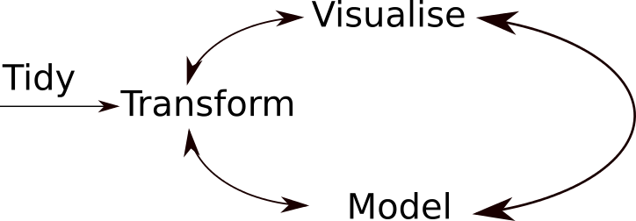

Slide 39
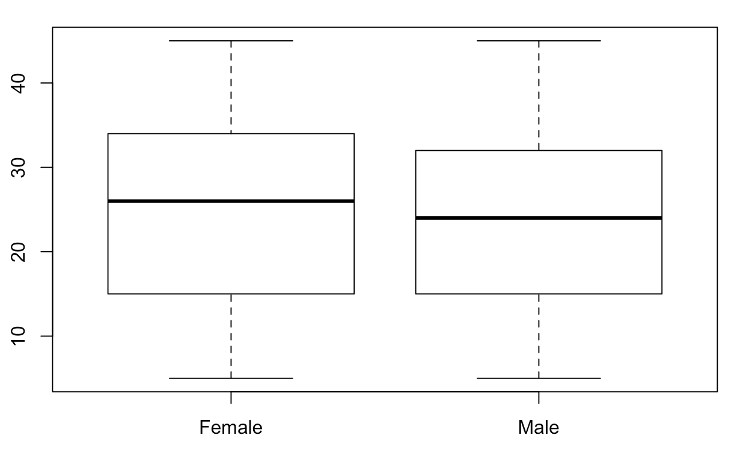
Visualising Data
Factors allow simple categorical data to visualised easily
boxplot(all.vent.data$PlateauPress ~ all.vent.data$Sex)

Slide 40
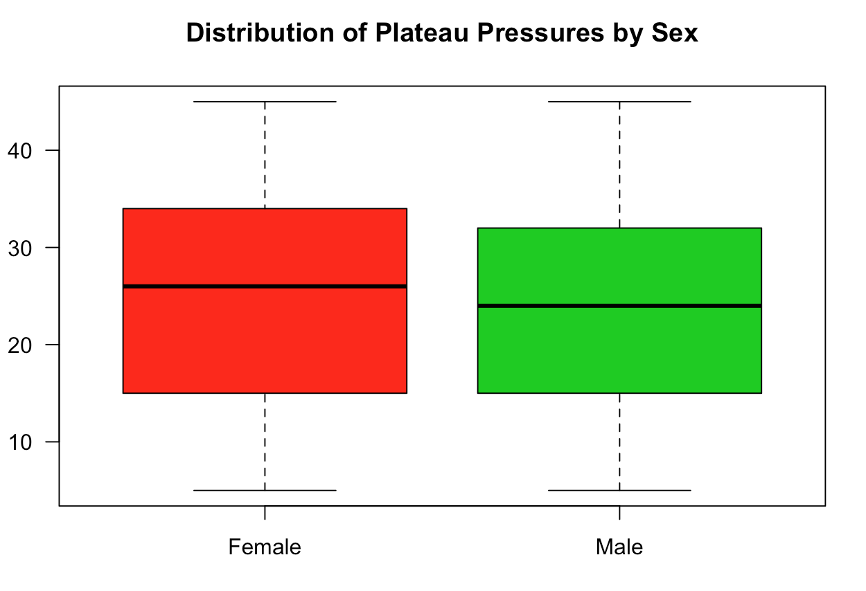
Visualising Data
boxplot(all.vent.data$PlateauPress ~ all.vent.data $Sex, col = c(2,3), main = 'Distribution of Plateau Pressures by Sex', ylab = 'Plateau Pressure (cmH2O)', las = 1)

Slide 41
Slicing
If we want to just look at one patient we can use the subset ( ) command
This looks at portion of a data frame which satisfies some logical condition
subset ( df$column wanted , logical condition to be met )

Slide 42
Slicing
x <- subset(all.vent.data$Ventilator.hour, all.vent.data$index == 1)
y <- subset(all.vent.data$PlateauPress.cmH20, all.vent.data$index == 1)
plot ( x, y ) or plot ( y ~ x )

Slide 43
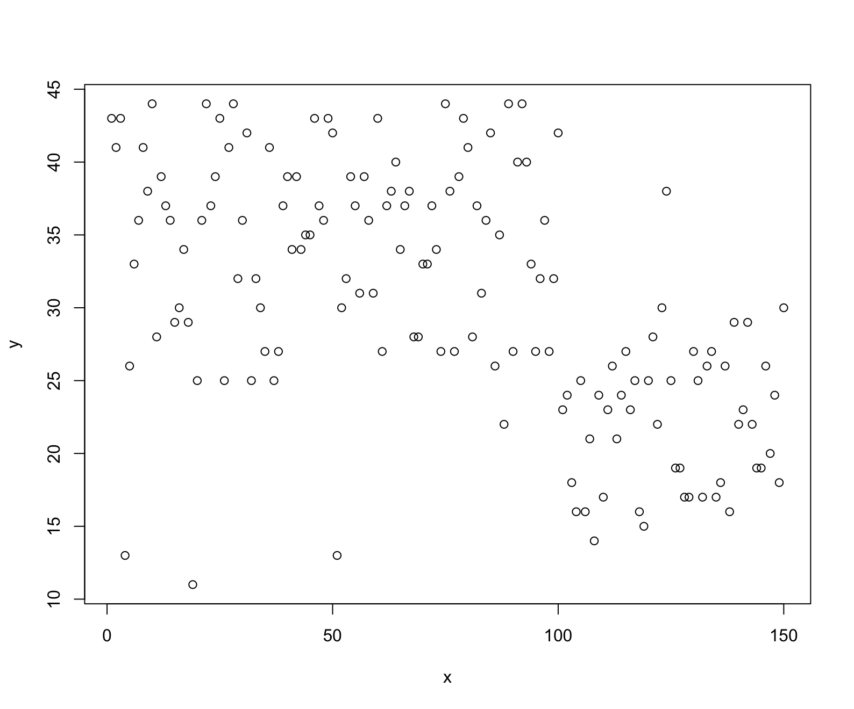

Slide 44
Make it look better
plot(y ~ x, xlab= 'Ventilation Duration (hours)', ylab = 'Peak pressure (cmH20)', main = 'Plateau pressures Over Time for Patient Index 1', pch= 19, cex = 0.7, las = 1, col = 'red3')

Slide 45
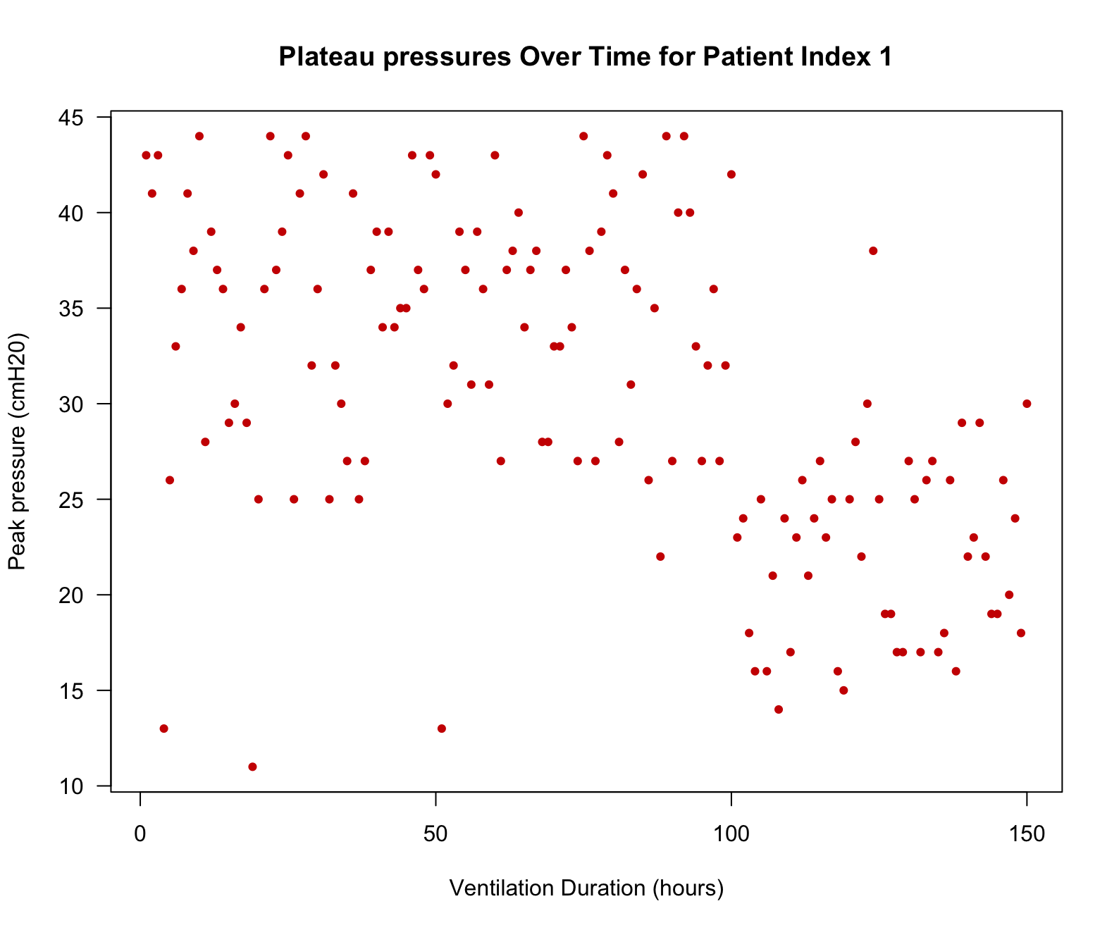

Slide 46
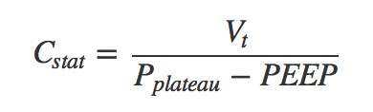
Analysis
all.vent.data$Cstat <- all.vent.data$TidalVol.ml / ( all.vent.data$PlateauPress.cmH20 – all.vent.data$PEEP.cmH20 )
attach(all.vent.data)
all.vent.data$Cstat <- tidal_vol.ml / (PlateauPress.cmH20 – PEEP.cmH2O)
detach(all.vent.data)

Slide 47
Analysis
Visualise! Visualise! Visualise! Visualise!
summary(all.vent.data)
What’s the problem?
hist(all.vent.data$Cstat, breaks = 100)

Slide 48
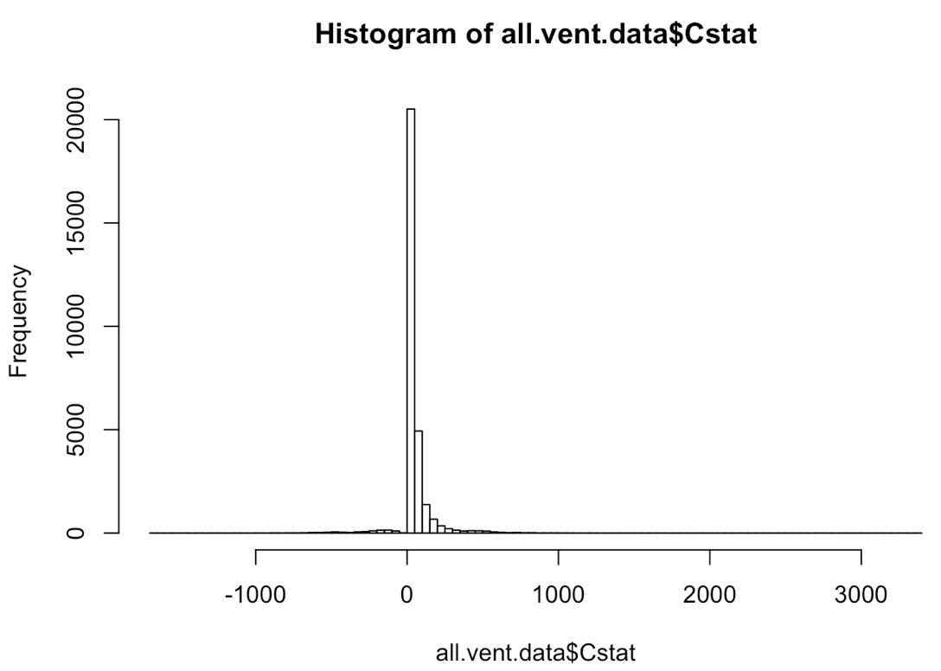

Slide 49
Interpret
Which rows are responsible for these bad values and can we inspect these data points?
bad_data <- which(all.vent.data$Cstat < 0)
all.vent.data[bad_data, ]
head (all.vent.data[bad_data, ], 15)

Slide 50
Clean
How can we go about cleaning these issues?

Slide 51
Annotation / Version Control
Use # to add comments to code
TIP: CTRL + SHIFT + C to comment out multiple lines simultaneously
GitHub
Markdown

Slide 52
R Markdown Document
Combination of R code and text
Can be used to write reports, presentations or interactive apps
Contains code, narrative, outputs and graphs

Slide 53
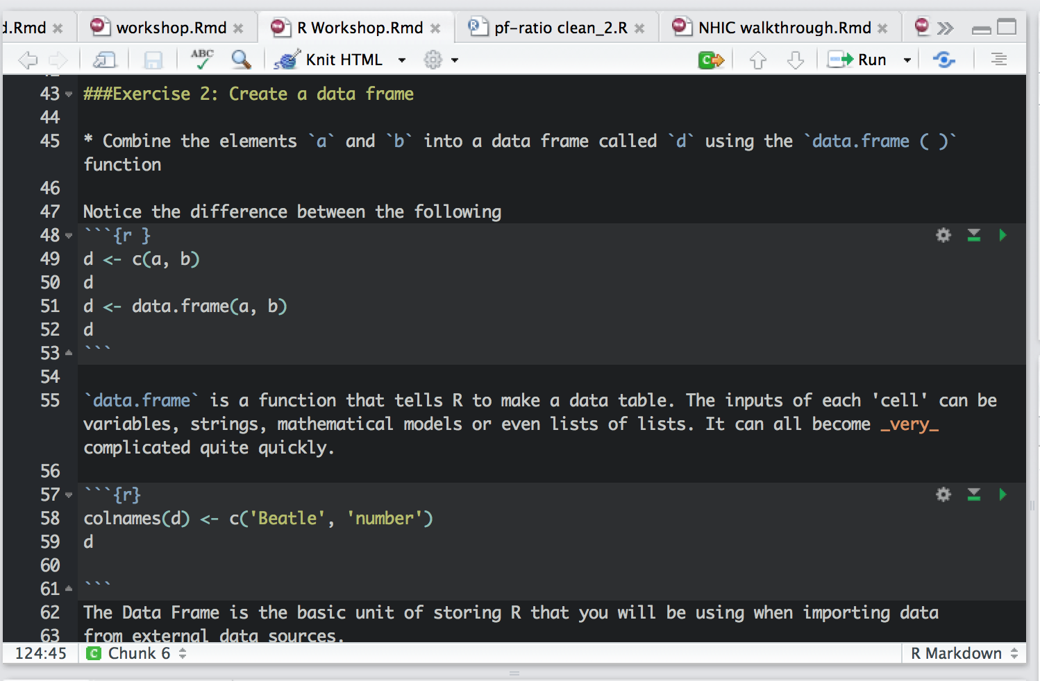

Slide 54
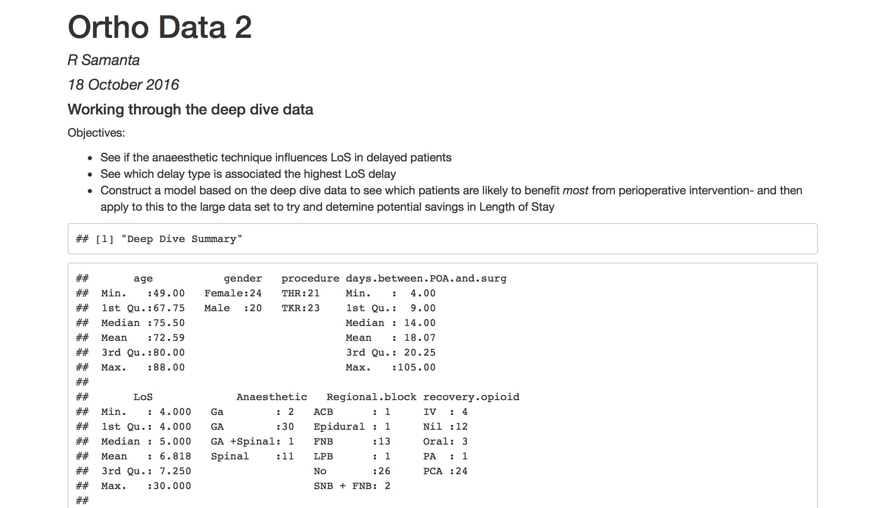

Slide 55
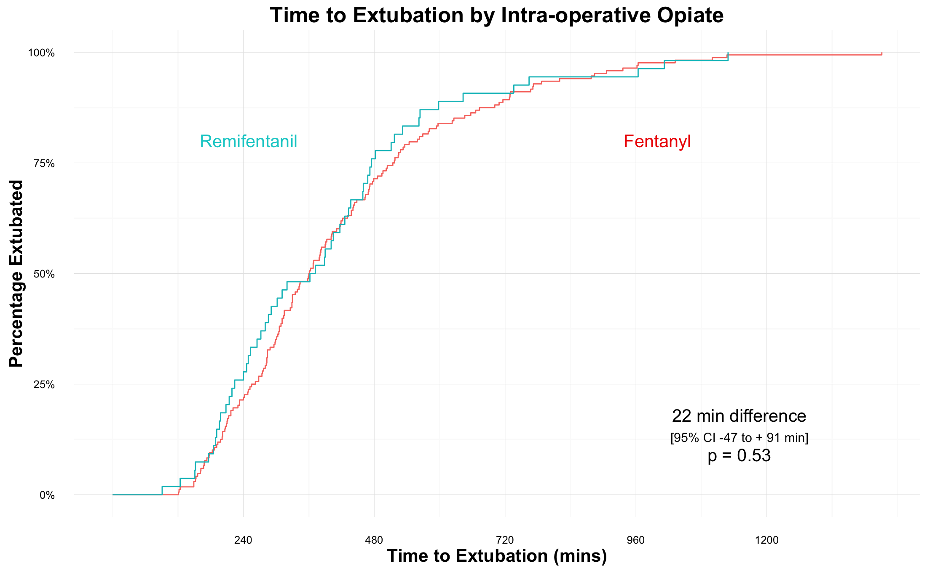

Slide 56
Results | Change in Creatinine
Sepsis
GI Surgery
Trauma

Slide 58
Thank you
Code School R course (free, very basic)
StackOverflow (for specific problems)
YouTube Hadley Wickham
Twitter #rstats @JennyBryan
Cambridge Bioinformatics training
All tutorial info and files available at:
https://github.com/dr-romster/Rtutorial
rs307@cam.ac.uk @dr_romster

Slide 59
Thank you
Code School R course (free, very basic)
StackOverflow (for specific problems)
YouTube Hadley Wickham
Twitter #rstats @JennyBryan
Cambridge Bioinformatics training
All tutorial info and files available at:
https://github.com/dr-romster/Rtutorial
rs307@cam.ac.uk @dr_romster

Slide 60
Exercise 4

Slide 61
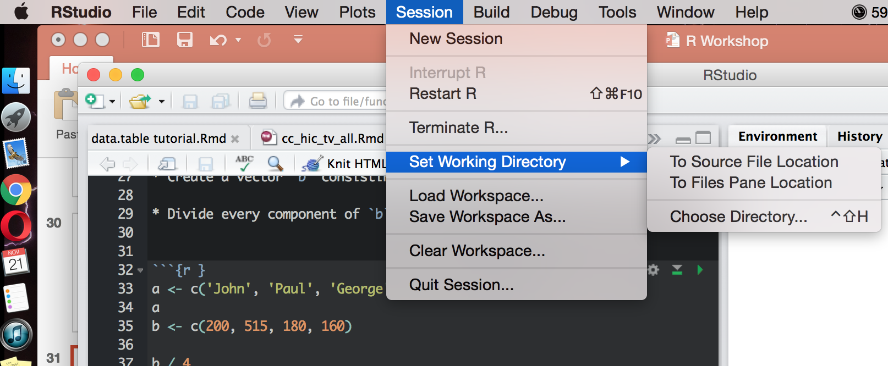
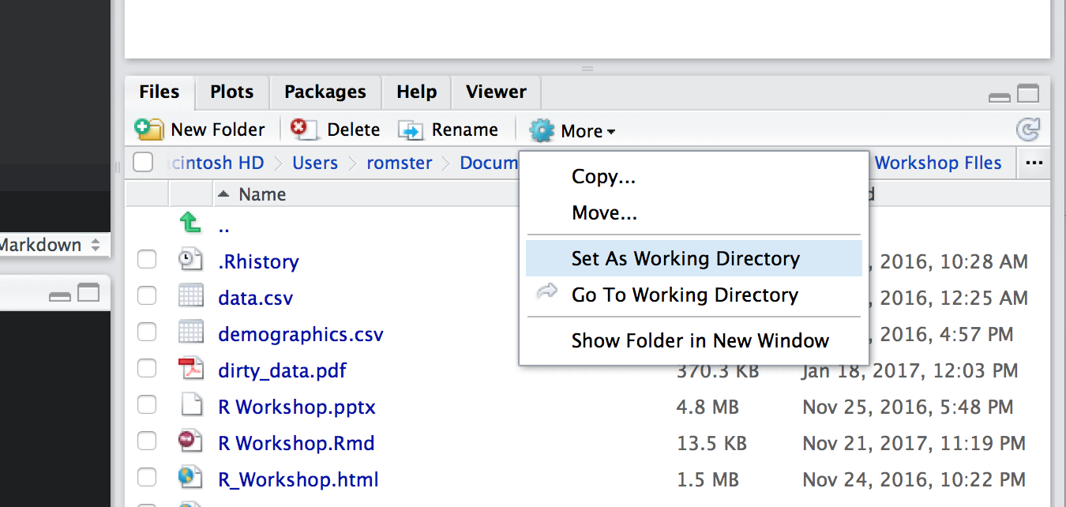
Set the working directory to the R Workshop folder on your Desktop
[ Session -> Set Working Directory ]

Slide 62
Import the data.csv file to a data frame called vent.data
Import the demographics.csv file to a data frame called demographics

Slide 64
Getting to Know Your Data
Call the dataframe
head( dataFrame.name )
tail (dataFrame.name, 10)
summary (dataFrame.name)

Slide 65
Merging Data Frames
Frequently required
unique(vent.data[1,])
unique(demographics$Hospital_no)
length(unique(vent.data[1,]))
length(unique(demographics$Hospital_no))

Slide 66
Merging Data Frames
Easier if we merge on a common term
colnames(vent.data)[1]<- “Hospital_No”
head(vent.data)
all.vent.data <-
merge(vent.data, demographics, by.demographics=“Hospital_No”)
head(all.vent.data)

